Slide 1

Go4Local
Rochana Dudwadkar
Prateek Revadi
Ashutosh Vishwakarma
Krishna Unnikrishnan

Slide 2

Vision

Slide 3



Unmet Needs
Local store grocery associates
Freedom and Accessibility
Delivery Charge
Premium Features

Slide 4

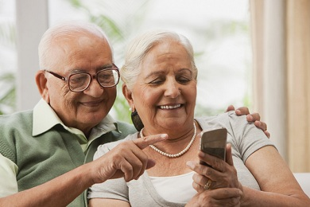

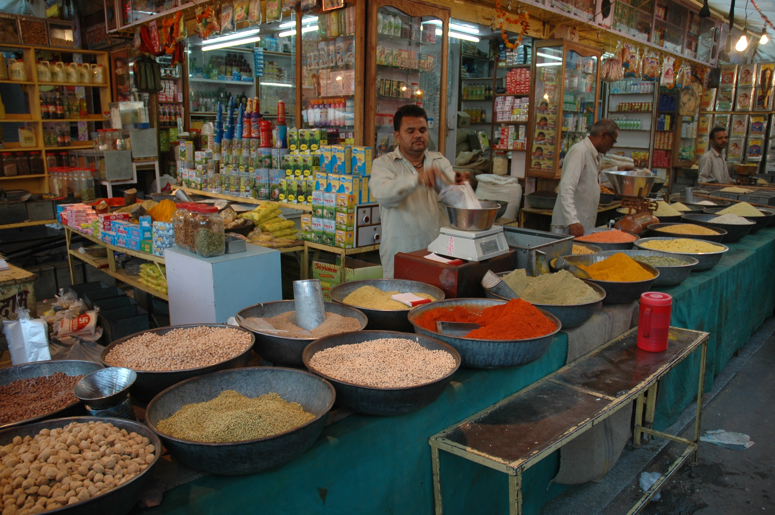
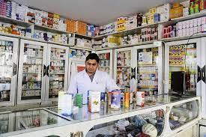
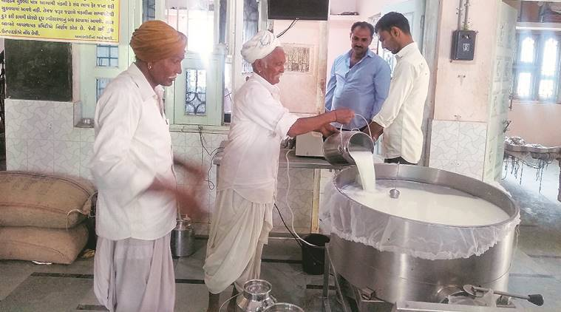
Customer Segments
B U Y E R S
Working professionals
Senior Citizens
Students
S E L L E R S
Grocery store owners
Pharmacy store owners
Dairy store owners

Slide 5
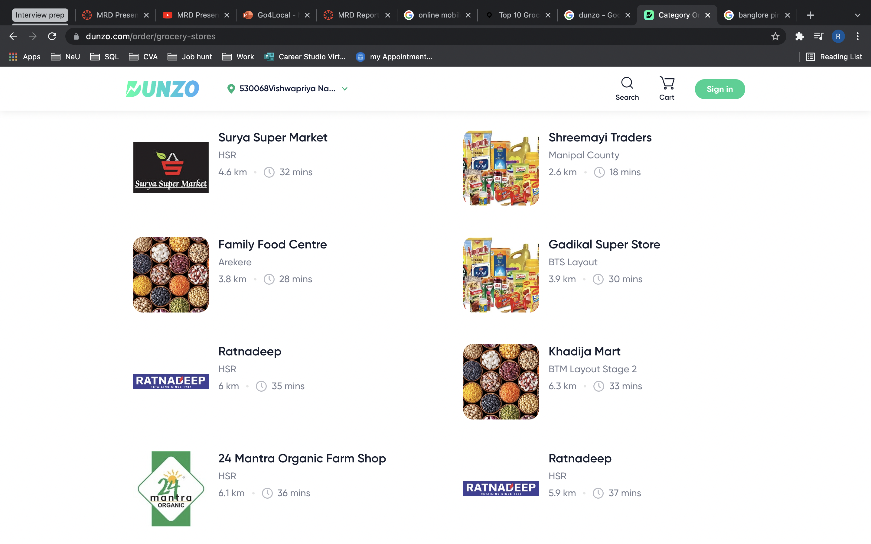
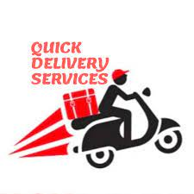
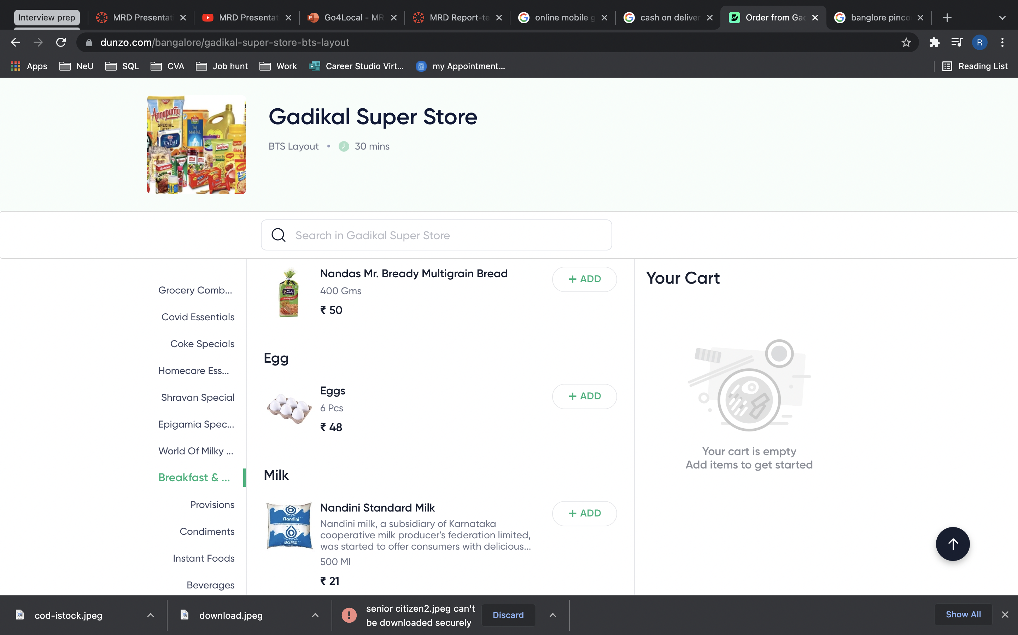
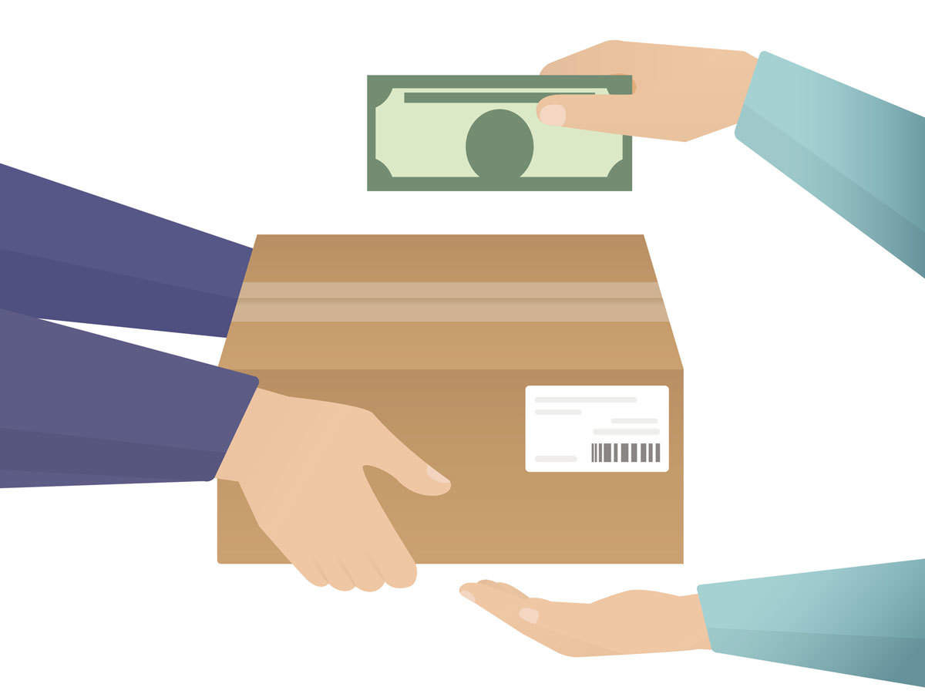
Use Cases- Buyers
Cash on Delivery
Fast delivery service
Quick selection of items

Slide 6


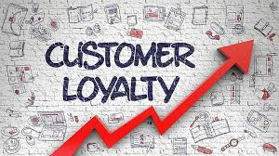
Use Cases- Sellers
Business growth
Time Saver
Trust

Slide 7
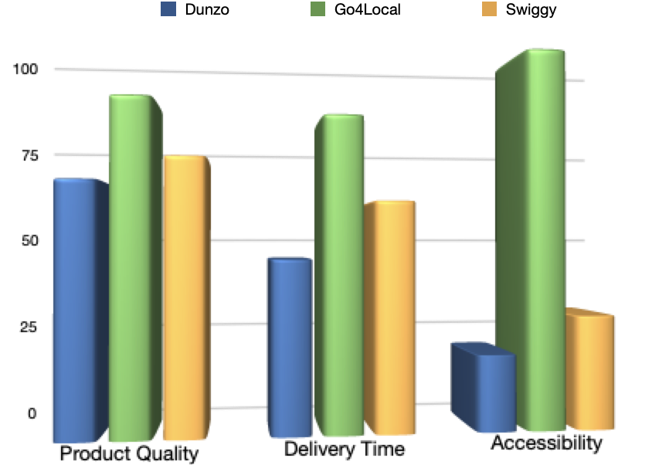
Competitive Analysis

Slide 8
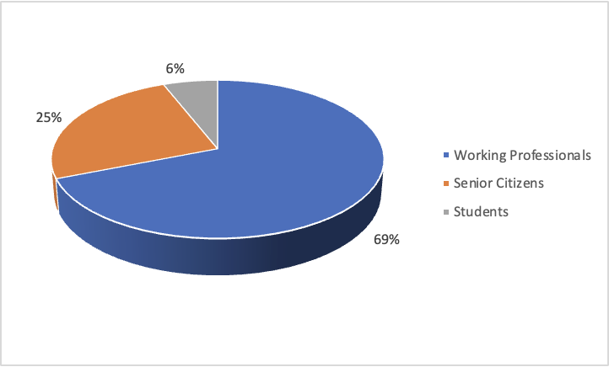
Market Sizing
Total Addressable Market (TAM)
TOTAL MARKET POTENTIAL
$1.1 Billion

Slide 9



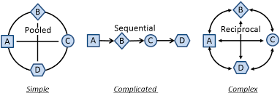
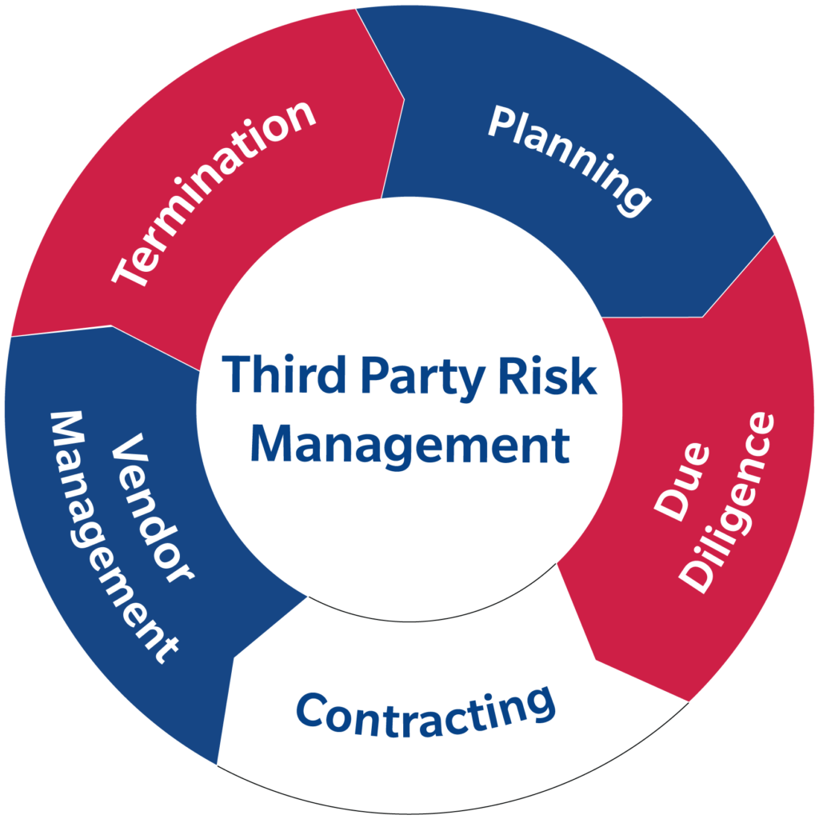
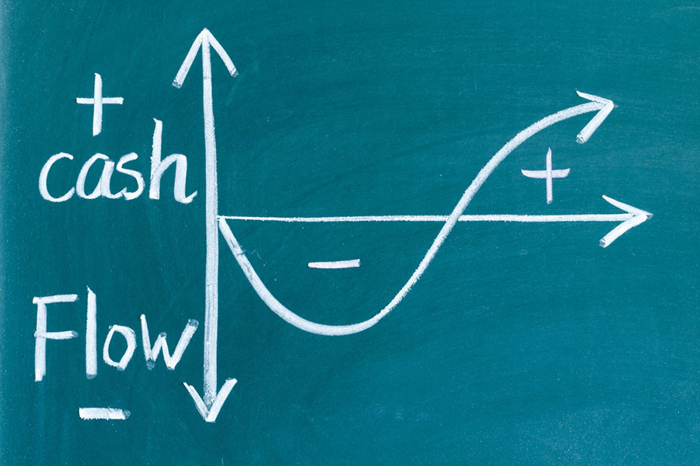
Risks/Dependencies & Mitigation Strategy
Privacy
Legal/Patent
Piracy
Interdependencies
Third party
Cash Flow

Slide 10
QUESTIONS

